Slide 1
KYNDRYL Shared Infra CH
Azure Landing Zone – Design
Wojciech Pazdzierkiewicz – Infrastructure Architect

Slide 2
Topics
Management groups structure
Subscriptions
Resource groups
Policies
RBAC

Slide 3
An Azure landing zone is the output of a multi-subscription Azure environment that accounts for scale, security governance, networking, and identity.
An Azure landing zone enables application migration, modernization, and innovation at enterprise-scale in Azure. This approach considers all platform resources that are required to support the customer's application portfolio and doesn't differentiate between infrastructure as a service or platform as a service.
Platform landing zones: Subscriptions deployed to provide centralized services, often operated by a central team, or a number of central teams split by function (e.g. networking, identity), which will be used by various workloads and applications. Platform landing zones represent key services that often benefit from being consolidated for efficiency and ease of operations. Examples include networking, identity, and management services.
Application landing zones: One or more subscriptions deployed as an environment for an application or workload. Application landing zones are placed in management groups like 'corp' or 'online' beneath the 'landing zones' management group to ensure policy controls are correctly applied.
What is an Azure landing zone? - Cloud Adoption Framework | Microsoft Docs

Slide 4
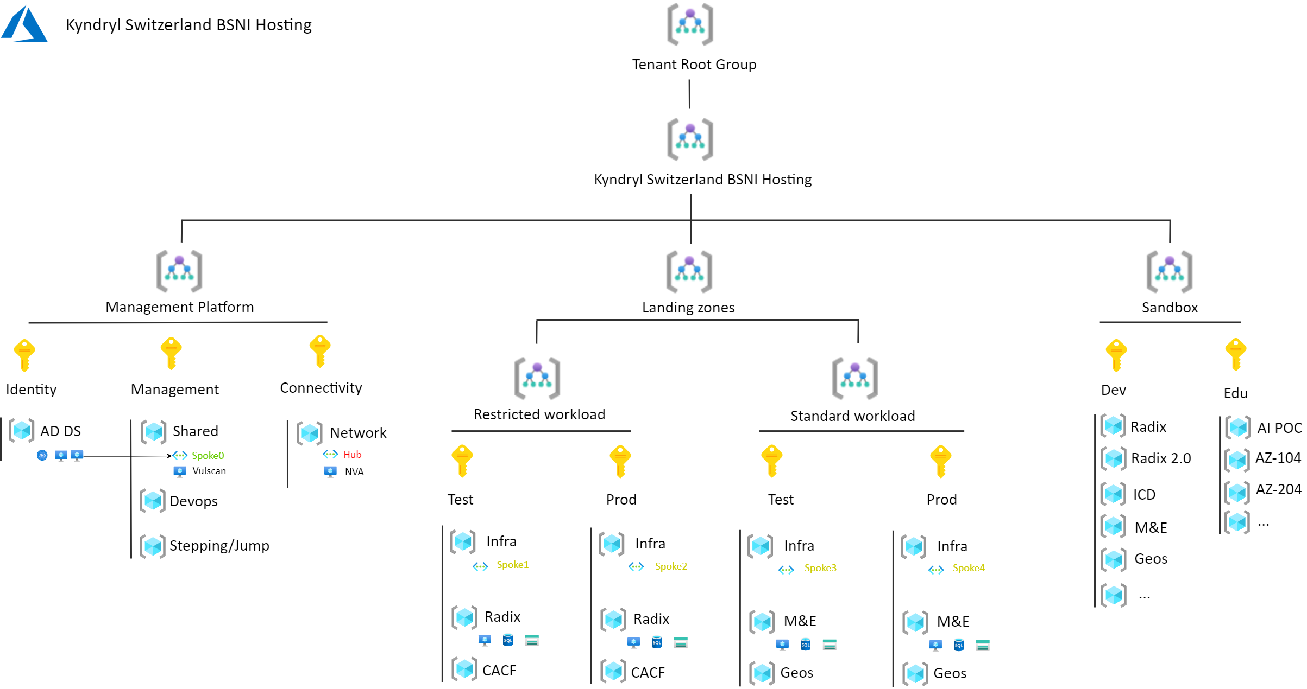
Management groups (option 1)

Slide 5
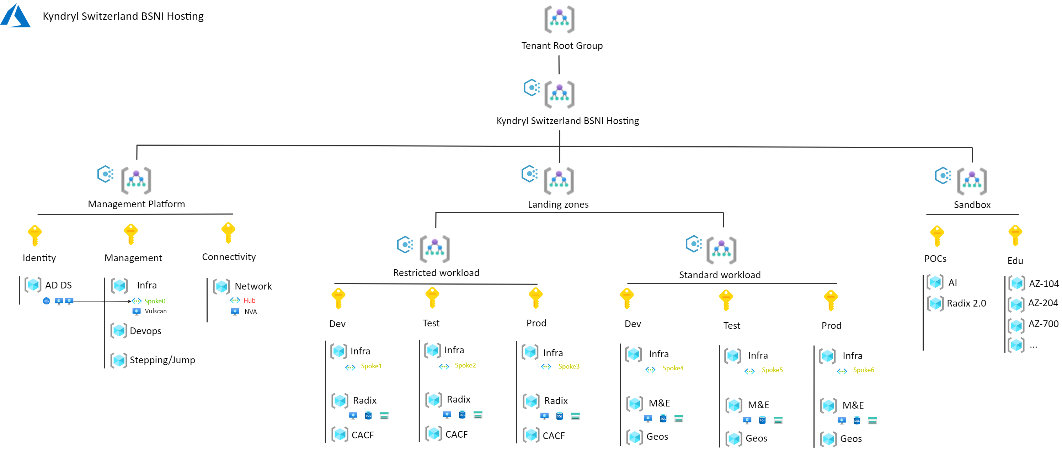
Management groups (option 2)

Slide 6
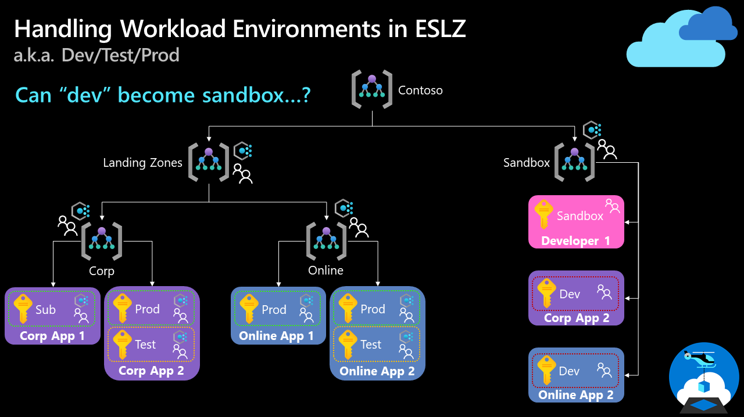
Enterprise-scale FAQ - Cloud Adoption Framework | Microsoft Docs

Slide 7
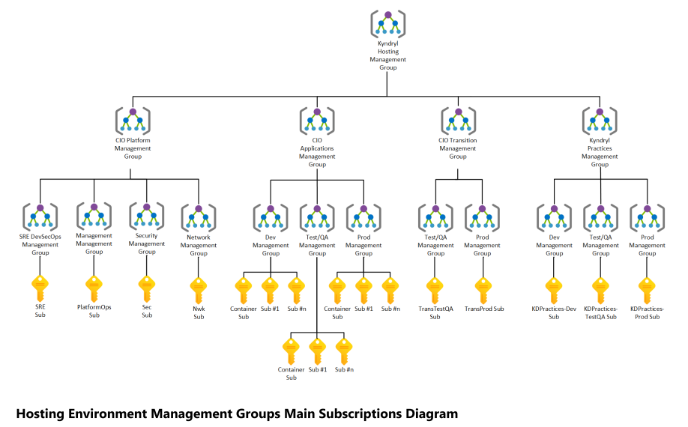
CIO: Hosting_Environment_Design_RFC

Slide 8
Policies
1 Require tagging (see tab 'Tags')
2 Enforce naming convention
3 Allow deployment of resources only into specific regions
4 Allowed locations for resource groups
5 Append resource with 'CanNotDelete' locks to production resource groups
6 Enforce Azure Backup is enabled
7 Prevent deployment of expensive resource SKUs
8 Block certain resource types
9 Limit available VM series to standard instance size flexibility groups
10 Audit if more than X Owners are configured Subscription
11 Audit if Key Vault Soft Delete is Enabled
12 Audit VMs that do not use managed disks
13 Deploy antimalware
14 Restrict publishers of VMs
15 Restrict operating system versions
16 Configure managed disks to disable public network access
17 All Internet traffic should be routed via Firewall deployed in Hub
18 Storage account public access to be disabled
19 Azure Guest Configuration
https://kyndryl.sharepoint.com/:x:/r/sites/BSNITransformationProjectTeam/Shared%20Documents/BSNI%20Landing%20Platform%20Design/Candidate%20Policies%20and%20Tags.xlsx?d=w282440abe9e74c3a8d11214f3b9cfa11&csf=1&web=1&e=W7DiTB

Slide 9
Resource groups
TSM Manager
Ansible, Ansible Tower
BlueCare
ITM6
Magic
Netcool
SMI Gateway
SRM
"TADDM (already decommissioned) "
TWS (already decommissioned from BSNI)
ACS
Apache
Domino
Firewall
IIS
ISIM
Login Server
Nessus
Radius
SOCKS
Vmware Smarts IP / SAM
WAS
Network Mgmt. Tools, IP Mgmt, DNS, Network Acess Control:CH_DAS_BSNI
ABC
BSCD
ICD
Reporting Solution
Sharepoint
Admin VMWare
Domain Controller
ESX BSNI
GEOS
NIM
Unix Admin
VMware Smarts NCM
VMWare Vcenter
Unix BSNI
Storage BSNI
Blue Wisdom
Antivirus
Puppet
Admin Storage
SAN NAV
TPC
TSM
https://kyndryl.sharepoint.com/:x:/r/sites/BSNITransformationProjectTeam/Shared%20Documents/BSNI%20Landing%20Platform%20Design/Candidate%20Policies%20and%20Tags.xlsx?d=w282440abe9e74c3a8d11214f3b9cfa11&csf=1&web=1&e=W7DiTB

Slide 10
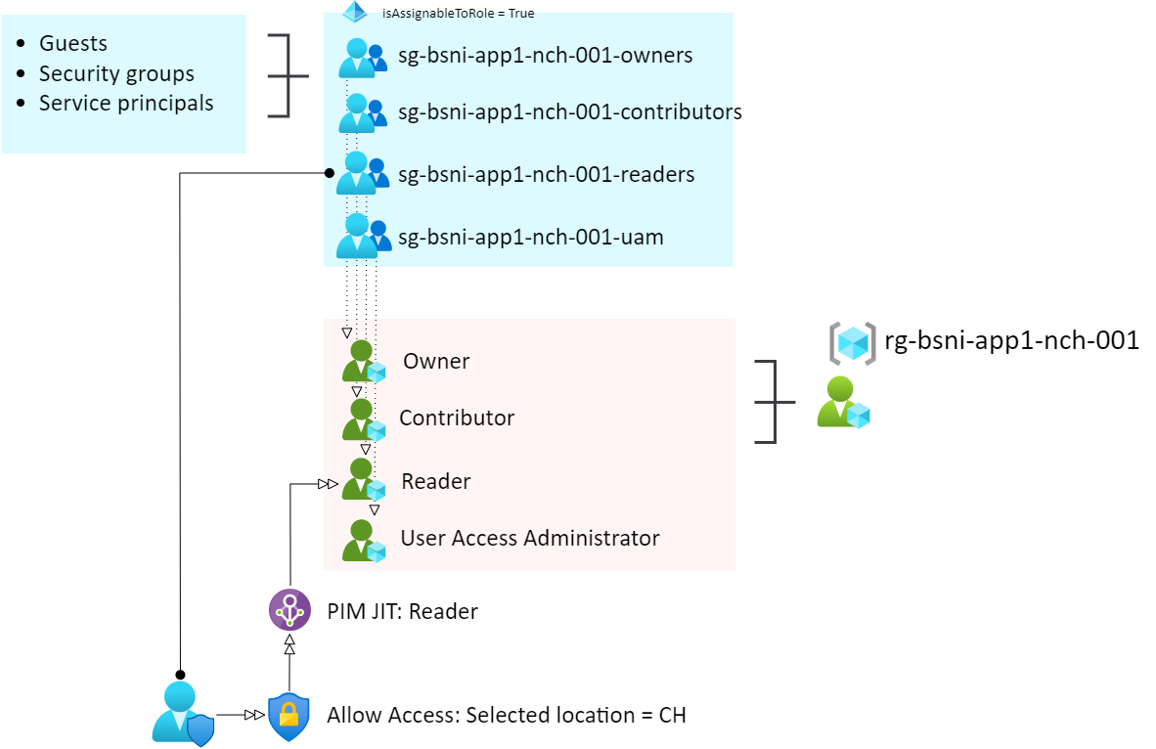
RBAC

Slide 11
THANK YOU

